Slide 1


Bhoj Reddy Engineering College for Women
(Sponsored by Sangam Laxmibai Vidyapeet, Accredited by NAAC with A Grade, Approved by AICTE and affiliated to JNTUH) Vinaynagar, IS Sadan Crossroads, Saidabad, Hyderabad – 500 059, Telangana. www.brecw.ac.in
Department of Computer Science and Engineering(AI&ML)
Real-time Research Project Design Seminar on
Toxic Comment Classification
RTP Coordinator: Syeda Fatima Date :24th April 2025
Assistant Professor Batch No :23RTP04
R.Manasa 23321A6633
B.Akshitha 23321A6602
A.Harshitha 23321A6613
Dr M Seshu Bhavani Dr J Madhavan
Associate Professor & HOD Professor & Principal

Slide 2
INTRODUCTION TO TOXIC COMMENTS
In today's digital age, toxic comments can significantly impact online interactions. Understanding and classifying these comments is crucial for fostering a healthier environment. This presentation will explore a comprehensive approach to decoding negativity and enhancing online communication.

Slide 3

SCOPE
The project leverages NLTK and TEXTBLOB for text pre processing , sentiment analysis and feature extraction to detect toxic online comments . It provides a light weight , rule based approach to classify harmful content, supporting further development of advanced models

Slide 4
EXISTING SYSTEM
Right now, YouTube uses basic tools to find bad comments. These tools look for certain harmful words and also use people to check comments. But they don’t always understand the true meaning of what people say. They can miss bad comments or remove good ones by mistake. They also don’t understand jokes, sarcasm, or cultural differences..
Disadvantages
Needs People to Check Comments: This takes a lot of time and effort.
Slow to Find Bad Comments: Detects Harmful comments very slowly .
Doesn’t Understand Context: Can’t recognize sarcasm, slang, or hidden meanings.
Can’t Handle Too Many Comments: Struggles when there are lots of comments.

Slide 5
PROPOSED SYSTEM
The new system will use smart technology (machine learning and NLP) to quickly find bad comments. It will not just look at words but also understand the meaning behind them. Tools like NLTK and TextBlob will help clean and analyze the text. This system can handle many comments at once and will help moderators keep YouTube safe.
Advantages
Quickly Finds Bad Comments: Detects harmful comments right away.
Understands Meaning: Gets sarcasm, slang, and hidden harmful messages.
Less Need for Human Checking: Automatically flags bad comments.
Handles Lots of Comments: Can process many comments at the same time.
Gets Smarter Over Time: Learns from new information and feedback.
Easy to Track Issues: Gives clear reports for moderators.

Slide 6
FUNCTIONAL REQUIREMENTS
User Module:
Lets users post comments and get alerts if flagged.
2. Admin Module:
Allows admins to manage users, check flagged comments, and view reports.
3. Machine Learning Module:
Finds toxic comments using smart language tools and keeps improving.
4. Dashboard Module:
Shows real-time data and reports about toxic comments.
5. Security Module:
Protects user data and controls who can access the system.
6. API Integration Module:
Connects with YouTube to collect and manage comments.

Slide 7
NON FUNCTIONAL REQUIREMENTS
Scalability – Handle large volumes of comments.
Speed – Classify comments quickly (within 2 seconds).
3. Accuracy & Fairness – Reduce false positives and bias.
4. Security & Privacy – Follow YouTube’s policies and protect user data.
5. Usability – Make the system easy to use.
6. Compliance – Follow legal and ethical guidelines (e.g., GDPR).

Slide 8
COMPUTATIONAL RESOURCES
Software Requirements:
1.Operating System
Windows 10 or later, macOS, or Linux (Ubuntu recommended for deployment)
2.Programming Language
Python 3.8+ for scripting and model development.
3.Libraries and Frameworks
NLP: NLTK, TextBlob.
Data Processing: Pandas, NumPy.
4.Development Tools
Jupyter Notebook or VS Code for coding and debugging.
5.Deployment Tools
Flask or FastAPI for building APIs.
6.Cloud Platforms (Optional)
AWS, Google Cloud, or Azure for hosting and scaling.
Hardware Requirements:
Processor: Intel Core i5 or equivalent (minimum).
RAM: 8 GB, 16 GB or higher recommended for training models.
Storage: At least 256 GB SSD for faster data access.

Slide 9
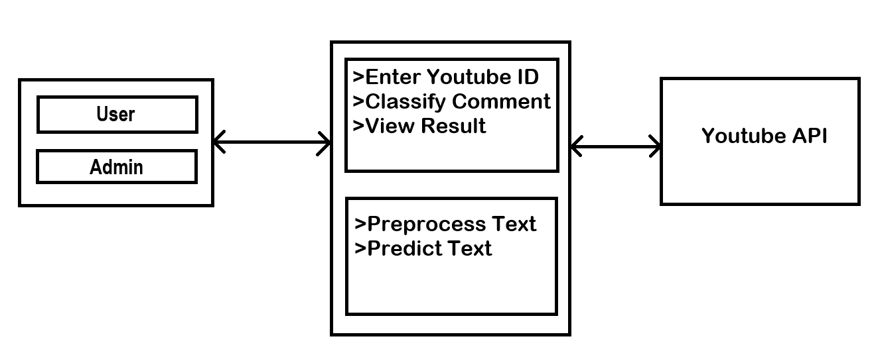
SOFTWARE ARCHITECTURE

Slide 10
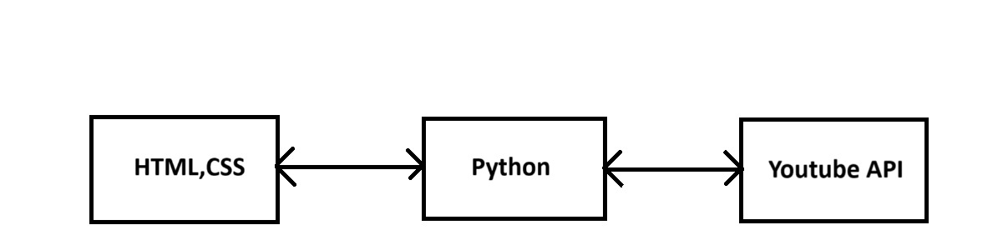
TECHNICAL ARCHITECTURE

Slide 11
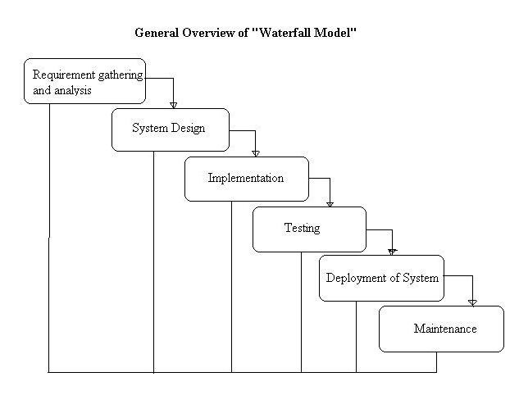
PROCESS MODEL
Waterfall Model:
.

Slide 12
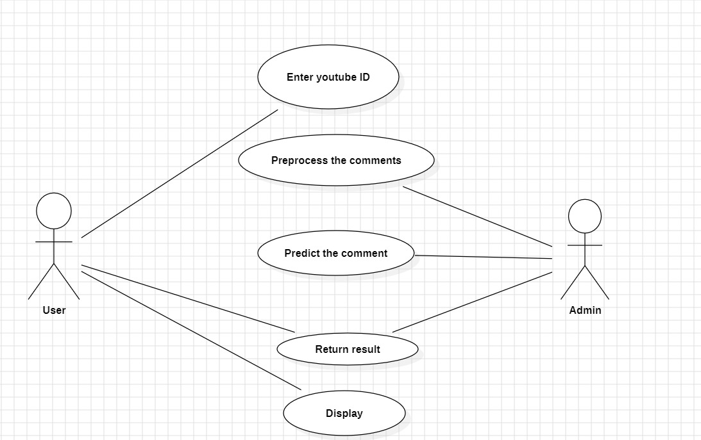
USE CASE DIAGRAM

Slide 13
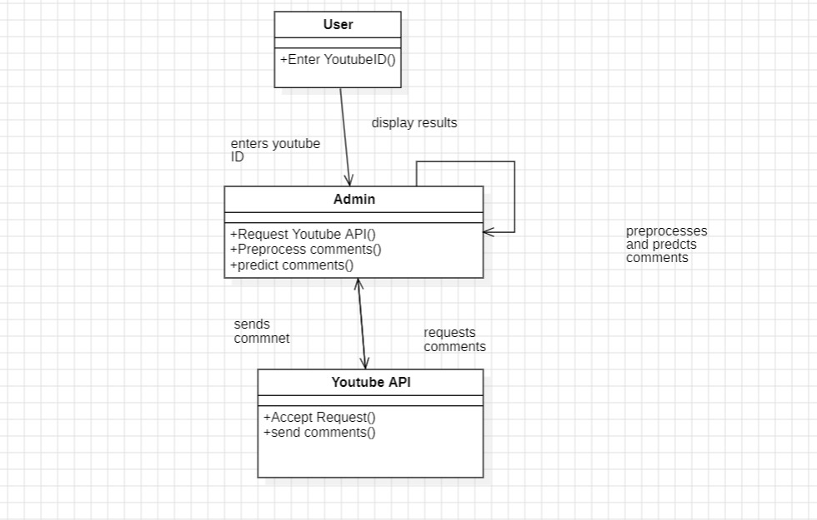
CLASS DIAGRAM

Slide 14
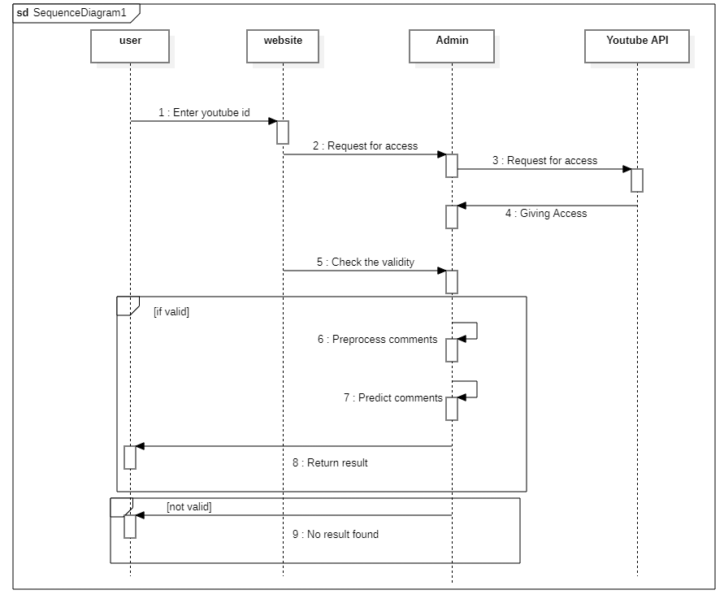
SEQUENCE DIAGRAM

Slide 15
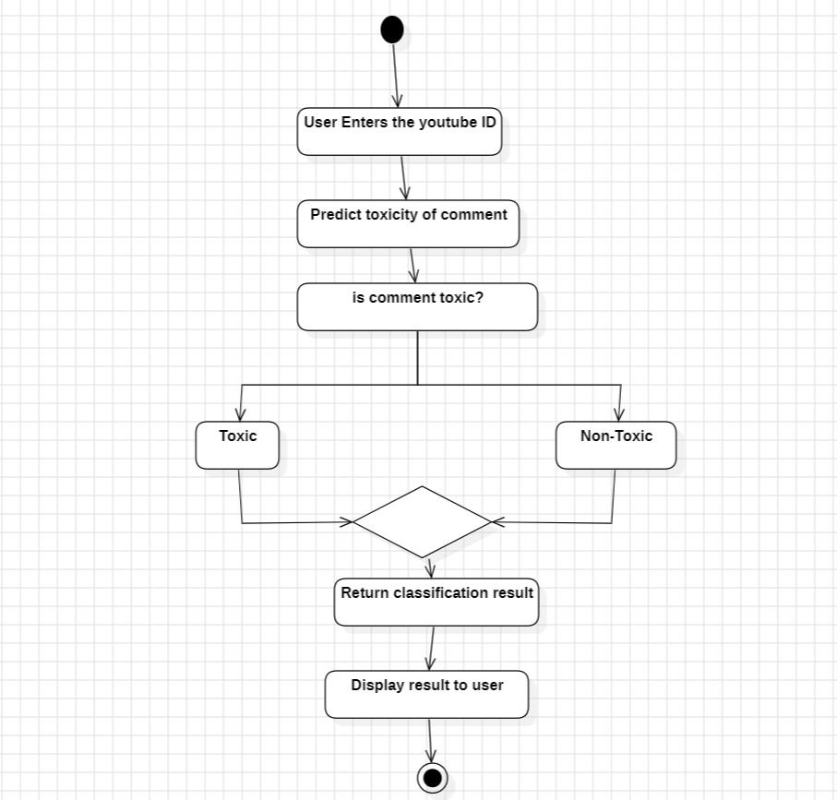
ACTIVITY DIAGRAM
Yes
No

Slide 16
/* Container for the main content */
.container {
Max-width: 800px;
Margin-top: 20px;
Background-color: #ffffff;
Padding: 30px;
Box-shadow: 0 4px 8px rgba(0, 0, 0, 0.1);
Border-radius: 8px;
}
/* Header styling */
H1 {
Font-size: 2rem;
Font-weight: 600;
Color: #333;
Text-align: center;
}
/* Form styling */
Form .form-group label {
Font-weight: 500;
Color: #555;
}
PSEUDO CODE
<!DOCTYPE html>
<html lang=”en”>
<head>
<meta charset=”UTF-8”>
<meta name=”viewport” content=”width=device-width, initial
scale=1.0”>
<title>YouTube Comment Toxicity Classifier</title>
<link rel=”stylesheet”
href=https://stackpath.bootstrapcdn.com/bootstrap/4.5.2/css/bootstr
ap.min.css>
<style>
/* General body styling */
Body {
Background-image:url(‘/static/pic.jpeg’);
Background-size:cover;
Background-position:center;
Background-repeat:no-repeat;
}

Slide 17
/* Error message styling */
.alert-danger {
Font-size: 0.9rem;
Border-radius: 6px;
}
/* Table styling */
.table {
Border-radius: 6px;
Overflow: hidden;
}
.table th {
Background-color: #007bff;
Color: white;
Font-weight: 600;
}
.table td {
Vertical-align: middle;
Font-size: 0.9rem;
}
.table tbody tr:nth-child(even) {
Background-color: #f2f2f2;
}
PSEUDO CODE
Form .form-control {
Border-radius: 6px;
Border: 1px solid #ced4da;
Box-shadow: inset 0 1px 3px rgba(0, 0, 0, 0.1);
}
/* Button styling */
.btn-primary {
Background-color: #007bff;
Border-color: #007bff;
Border-radius: 6px;
Font-weight: 600;
}
.btn-primary:hover {
Background-color: #0056b3;
Border-color: #0056b3;
}

Slide 18
<body>
<div class=”container”>
<h1 class=”mt-5”>YouTube Comment Toxicity Classifier</h1>
<!—Input form for YouTube video ID →
<form action=”/process” method=”post” class=”mt-4”>
<div class=”form-group”>
<label for=”video_id”>Enter YouTube Video
ID:</label>
<input type=”text” class=”video_id” id=”video_id”
name=”video_id” required>
</div>
<button type=”submit” class=”btn btn-primary”>Process
Comments</button>
</form>
<!—Display error if any →
{% if error %}
<div class=”alert alert-danger mt-4”>{{ error }}</div>
{% endif %}
<!—Display comments and toxicity analysis →
{% if comments %}
<h3 class=”mt-5”>Comments for Video ID: {{ video_id }}</h3>
PSEUDO CODE
/* Toxicity label and score colors */
.td-toxicity-label {
Font-weight: 600;
Color: #d9534f; /* Red for toxic comments */
}
.td-toxicity-score {
Font-weight: 500;
Color: #333;
}
/* Responsive adjustments */
@media (max-width: 576px) {
.container {
Padding: 20px;
}
H1 {
Font-size: 1.8rem;}
</style>
</head>

Slide 19
</tbody>
</table>
{% endif %}
</div>
</body>
</html>
From flask import Flask, render_template, request
Import googleapiclient.discovery
Import pandas as pd
From textblob import TextBlob
# Initialize Flask app
App = Flask(__name__)
# YouTube API setup
Api_service_name = “youtube”
Api_version = “v3”
DEVELOPER_KEY = “AizaSyAJsP1D2KwOoCZrNwpcyWMJWY5eq2T4ONQ”
Def classify_sentiment(comment):
# Create a TextBlob object
Blob = TextBlob(comment)
# Get polarity and subjectivity
Polarity = blob.sentiment.polarity
PSEUDO CODE
<table class=”table mt-3”>
<thead>
<tr>
<th>Published At</th>
<th>Comment</th>
<th>sentiment</th>
<th>polarity</th>
</tr>
</thead>
<tbody>
{% for comment in comments %}
<tr>
<td>{{ comment.published_at }}</td>
<td>{{ comment.text }}</td>
<td>{{ comment.sentiment }}</td>
<td>{{ comment.polarity }}</td>
</tr>
{% endfor %}

Slide 20
Comments = []
For item in response[‘items’]:
Comment = item[‘snippet’][‘topLevelComment’][‘snippet’]
Comments.append({
‘author’: comment[‘authorDisplayName’],
‘published_at’: comment[‘publishedAt’],
‘updated_at’: comment[‘updatedAt’],
‘like_count’: comment[‘likeCount’],
‘text’: comment[‘textDisplay’]
})
Return comments
# Home route
@app.route(‘/’)
Def index():
Return render_template(‘index.html’)
# Route to process YouTube video ID and display comments
@app.route(‘/process’, methods=[‘POST’])
Def process_comments():
Video_id = request.form[‘video_id’]
If not video_id:
Return render_template(‘index.html’, error=”Please enter a valid YouTube video ID.”)
PSEUDO CODE
Subjectivity = blob.sentiment.subjectivity
# Define a simple rule for toxic comments based on polarity
If polarity < -0.5: # If sentiment is negative and very strong
Sentiment = “Toxic”
Elif polarity > 0.5: # If sentiment is positive
Sentiment = “Non-Toxic”
Else:
Sentiment = “Neutral”
# You can also consider subjectivity to help in classification
(optional)
Return sentiment, polarity, subjectivity
# Fetch comments from YouTube API
Def fetch_comments(video_id):
Youtube = googleapiclient.discovery.build(api_service_name,
api_version, developerKey=DEVELOPER_KEY)
Request = youtube.commentThreads().list(part=”snippet”,
videoId=video_id, maxResults=10)
Response = request.execute()

Slide 21
PSEUDO CODE
# Fetch comments from the video
Comments_data = fetch_comments(video_id)
# Process and classify the comments
For comment in comments_data:
Data=comment[‘text’]
Sentiment,polarity,subjectivity = classify_sentiment(data)
Comment[‘sentiment’] = sentiment
Comment[‘polarity’] = polarity
Comment[‘subjectivity’]=subjectivity
Return render_template(‘index.html’, comments=comments_data,
video_id=video_id)
If __name__ == ‘__main__’:
App.run(debug=True)

Slide 22
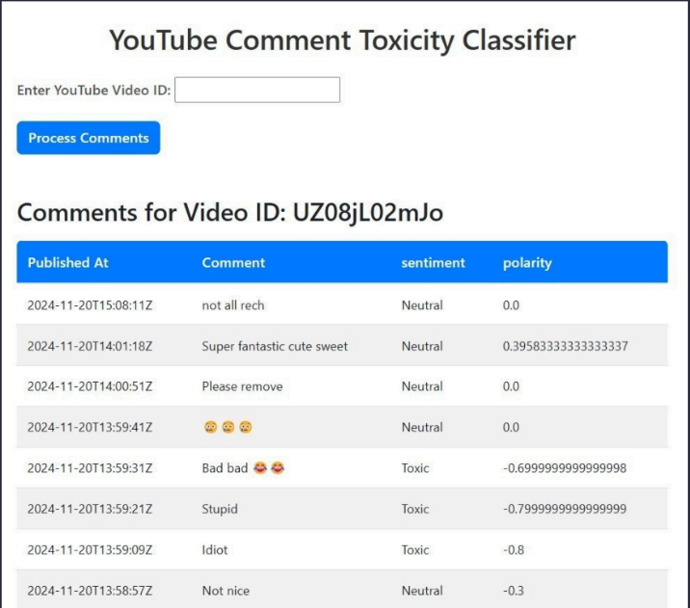
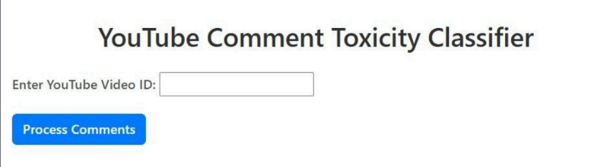
OUTPUT

Slide 23
REFERENCES
Resources Used
• HTML and CSS:W3 Schools
HTML Site-https://www.w3schools.com/html/default.asp
CSS Site-https://www.w3schools.com/css/default.asp
• NLP:Coursera
https://www.coursera.org/articles/natural-language-processing

Slide 24
CONCLUSION
The toxic comments classification project successfully developed a robust model capable of identifying and categorizing harmful content. By leveraging advanced natural language processing techniques, the model demonstrated high accuracy in detecting toxicity across various categories such as hate speech, abuse, and threats. This achievement highlights its potential for enhancing online moderation systems and fostering healthier digital environments. However, challenges such as contextual nuances and bias in training data were encountered, emphasizing the need for continuous improvement. Overall, the project underscores the critical role of AI in addressing online toxicity while advocating for ethical implementation and ongoing refinement for real-world applications.

Slide 25
FUTURE SCOPE
Future improvements for the toxic comment classification project can focus on enhancing accuracy, fairness, and adaptability. Using diverse datasets will reduce bias and improve detection across languages and cultures. Fine-tuning the model for sarcasm, context, and nuanced language will increase reliability.
Advanced models like BERT or GPT can boost performance, while real-time detection can support live moderation. Ethical aspects like transparency, privacy, and reducing false positives are also important. Collaboration with experts and user feedback will help the system evolve with changing online behavior.

Slide 26
Thank You

